Slide 1
A Variation of the Buffon’s Needle and Coin Problems
Lau Hong Rui
Ng Wei En
Jared Cheang
Benjamin Tan

Slide 2
Introduction

Slide 3
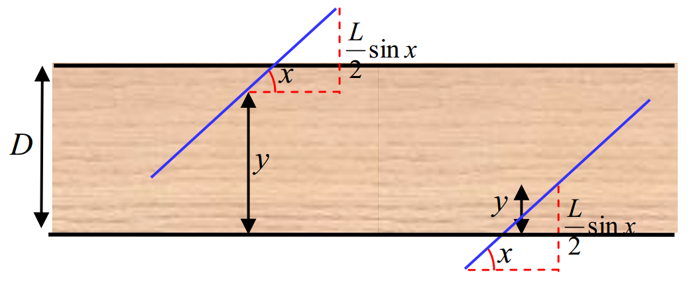
Buffon’s Needle Problem
0 ≤ y < D

Slide 4

Buffon’s Coin Problem
D
R
R
R

Slide 5
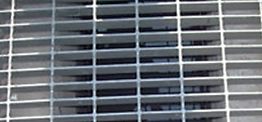
Variation of Buffon’s Needle and Coin problem

Slide 6
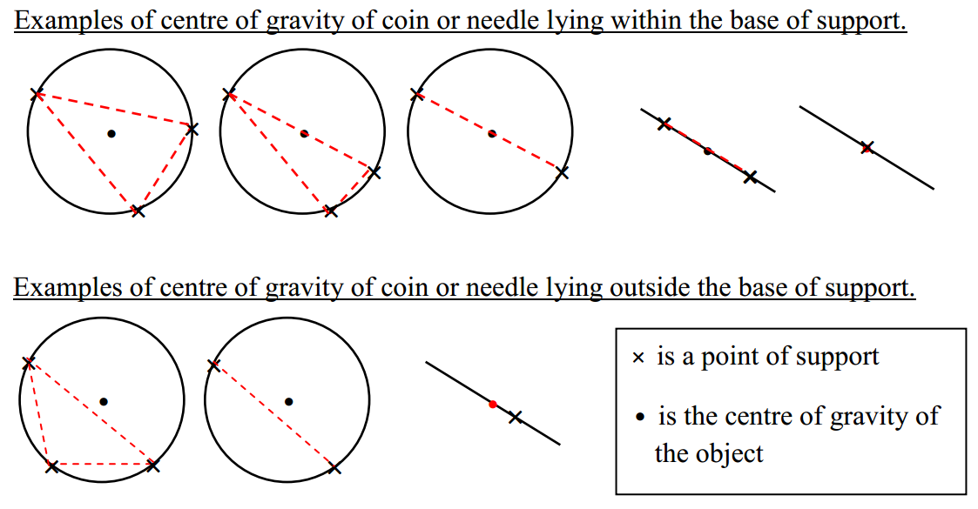
Centre of Gravity & Balancing

Slide 7
Centre of Gravity & Balancing
Masses of needle and coin are uniformly distributed
Centre of gravity lies in the middle of the needle and the coin

Slide 8
Objectives
Derive formulae to calculate probability of needle and coin balancing
Create computer simulations to verify formulae
Apply formulae to find best combination of $1 worth of coins to carry

Slide 9
Deriving our Formulae

Slide 10
Variation of Buffon’s Needle Problem
Needle balances when:
the center of the needle lies on the bottom line, or
the needle crosses both lines
•
•

Slide 11
Case 1
When the center of the needle lies on the bottom line,

Slide 12
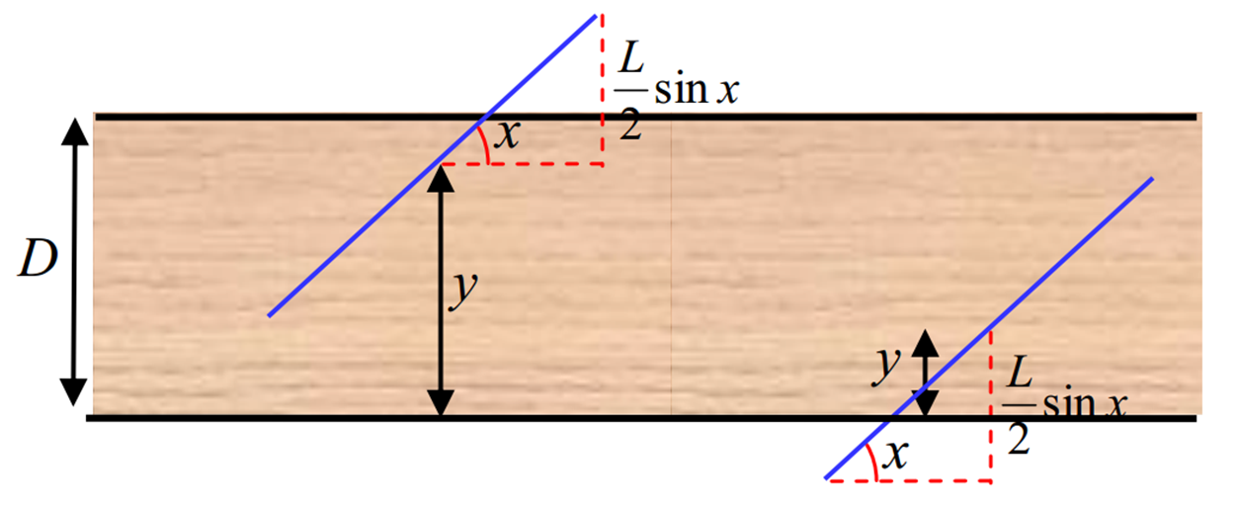
Case 2
When the needle crosses both lines,

Slide 13
L ≤ D
L > D
L
D
L

Slide 14
L ≤ D
Length of the needle is shorter than or equal to the distance between the 2 cracks
D
L

Slide 15
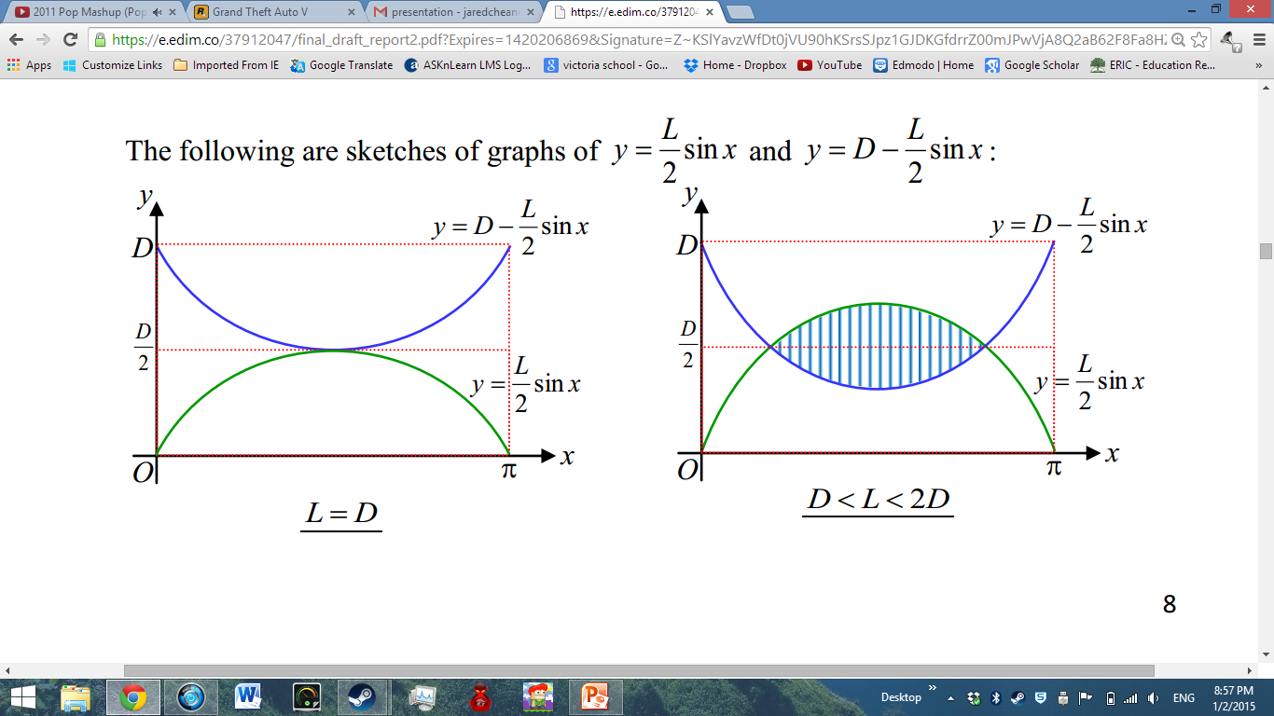
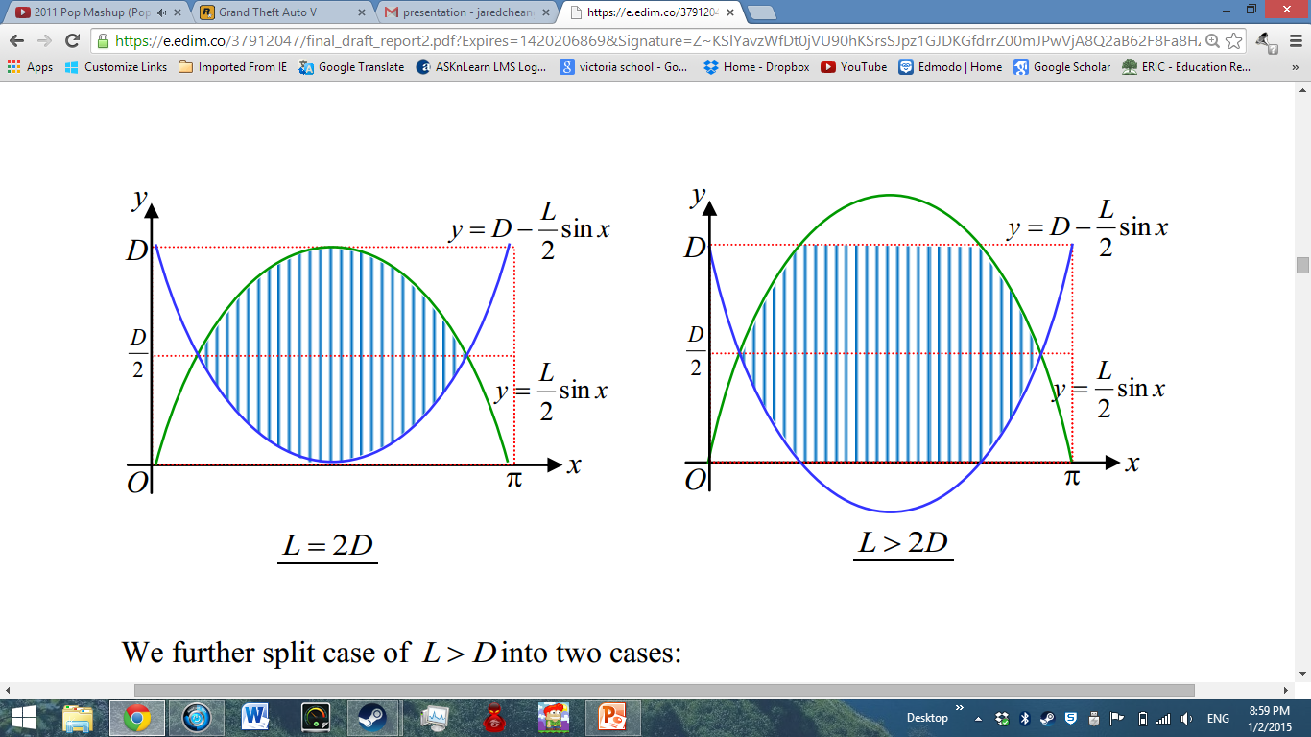
L > D

Slide 16
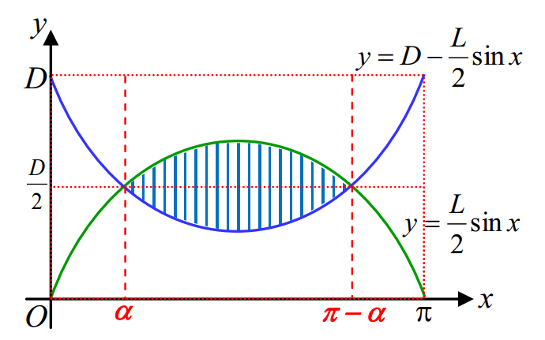

Slide 18
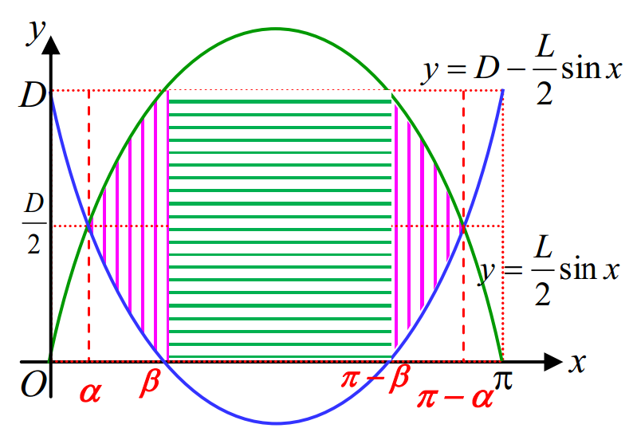

Slide 21
where L is the length of the needle and D is the distance between the 2 parallel edges.

Slide 22
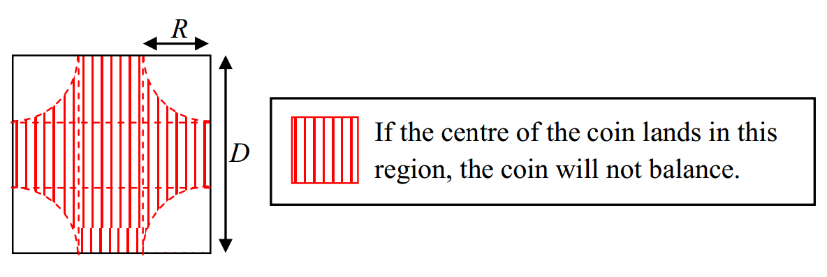
Variation of Buffon’s Coin Problem
The coin balances when the centre of the coin lies:
(a) on the edge or corner
(b) in any of the 4 quadrants with radius equal to radius of the coin*
*

Slide 23
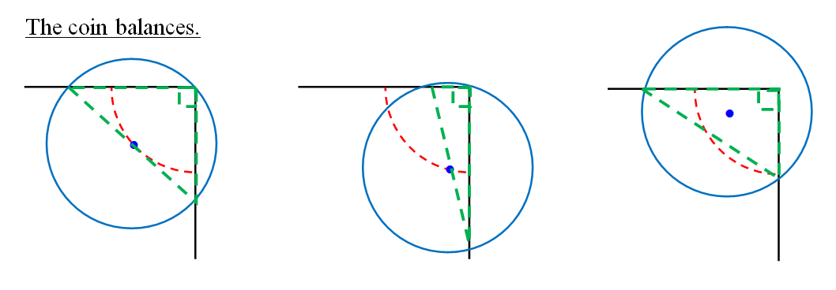
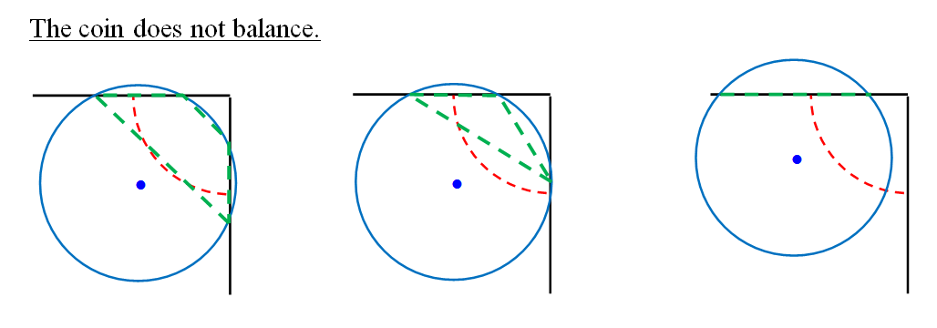

Slide 24
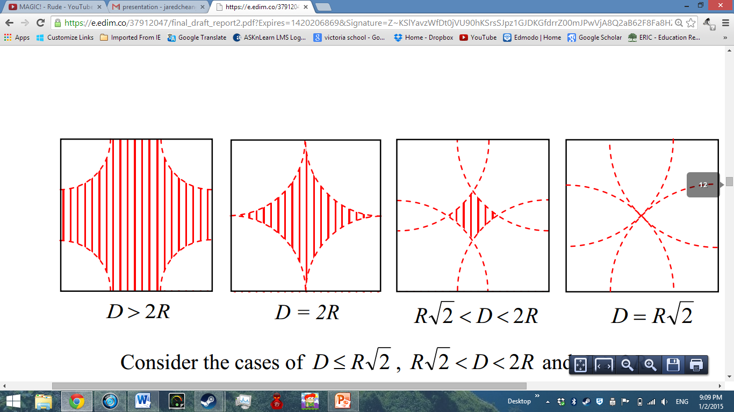
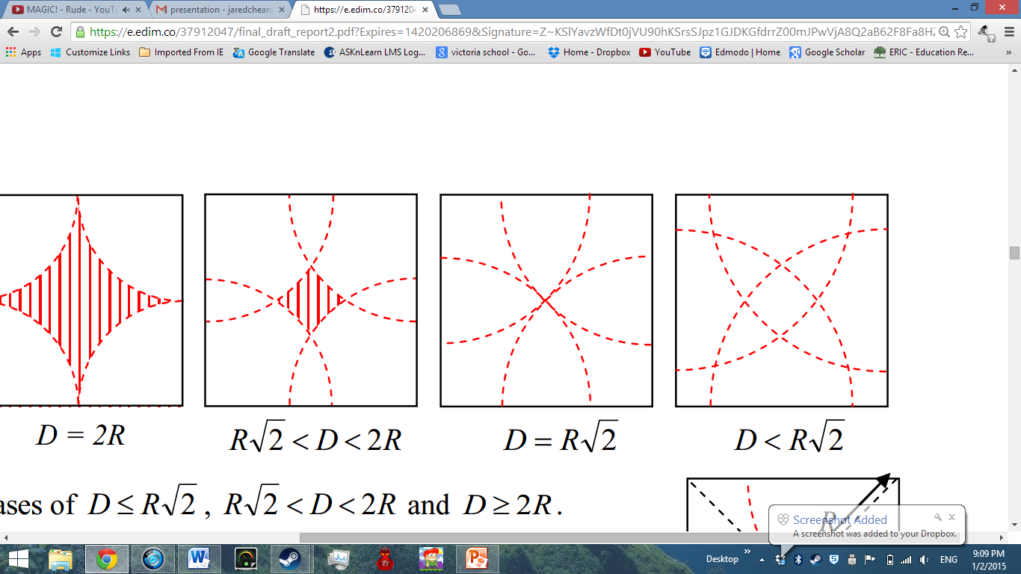
*

Slide 25
*

Slide 27
*

Slide 29
*

Slide 30
*

Slide 31
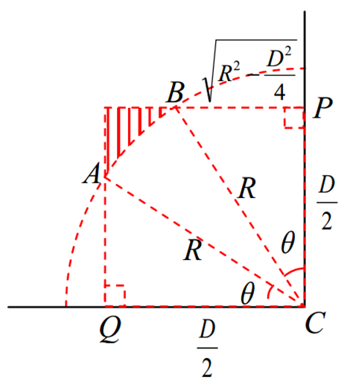
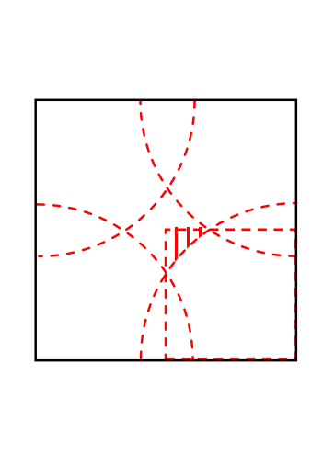
*

Slide 32
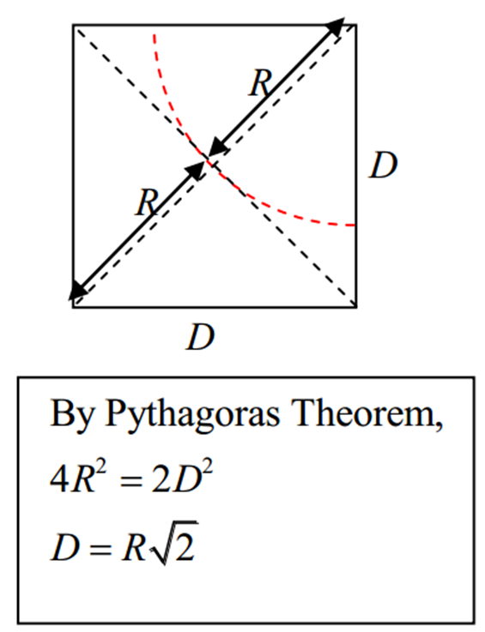
*

Slide 36
≥

Slide 37
where R is the radius of coin and D is the length of side of the square grid.

Slide 38
where R is the radius of coin and D is the length of side of the square grid.

Slide 39
Simulations of our Variations

Slide 40
Simulation of Variation of Buffon’s Needle Problem
Generate random values of x and y which represent the angle of the needle and distance from bottom line.
Tally a hit if:
Centre of needle lies on bottom line, or
Needle crosses both top and bottom line

Slide 41
Simulation of Variation of Buffon’s Coin Problem
Generate random values of x and y which represent the coordinates of the centre of the coin.
Find the supporting points of the coin
Tally a hit if:
Centre lies on edge, or
Coin has 2 x-intercepts and 2 y-intercepts and
Centre lies in base of support of coin

Slide 42
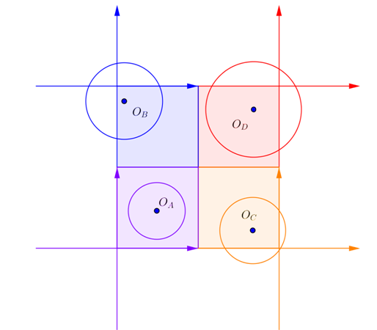

Slide 43
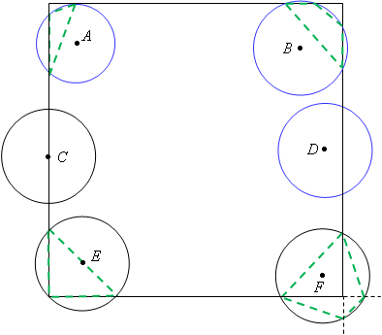

Slide 44
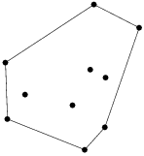
How to check if the centre lies in the base of support?
The convex hull of a set of points in a Euclidean plane is defined as the smallest set of points where every point on a straight line segment joining a pair of points is within the set.
Andrew’s monotone chain algorithm

Slide 45
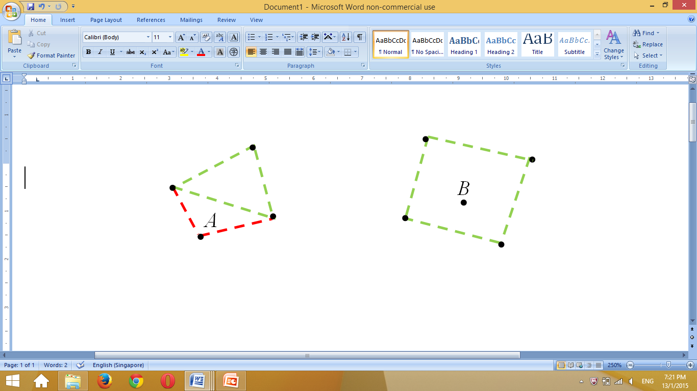
3 supporting points
4 supporting points
D
C

Slide 46
Comparing Our Simulation with Our Formulae

Slide 47
Chi-Square Test
Degree of freedom = 1
p-value = 0.05
Critical value = 3.841

Slide 48
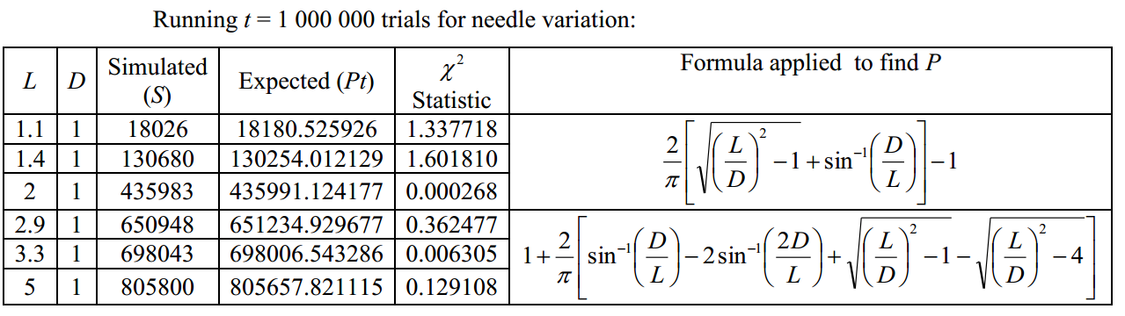
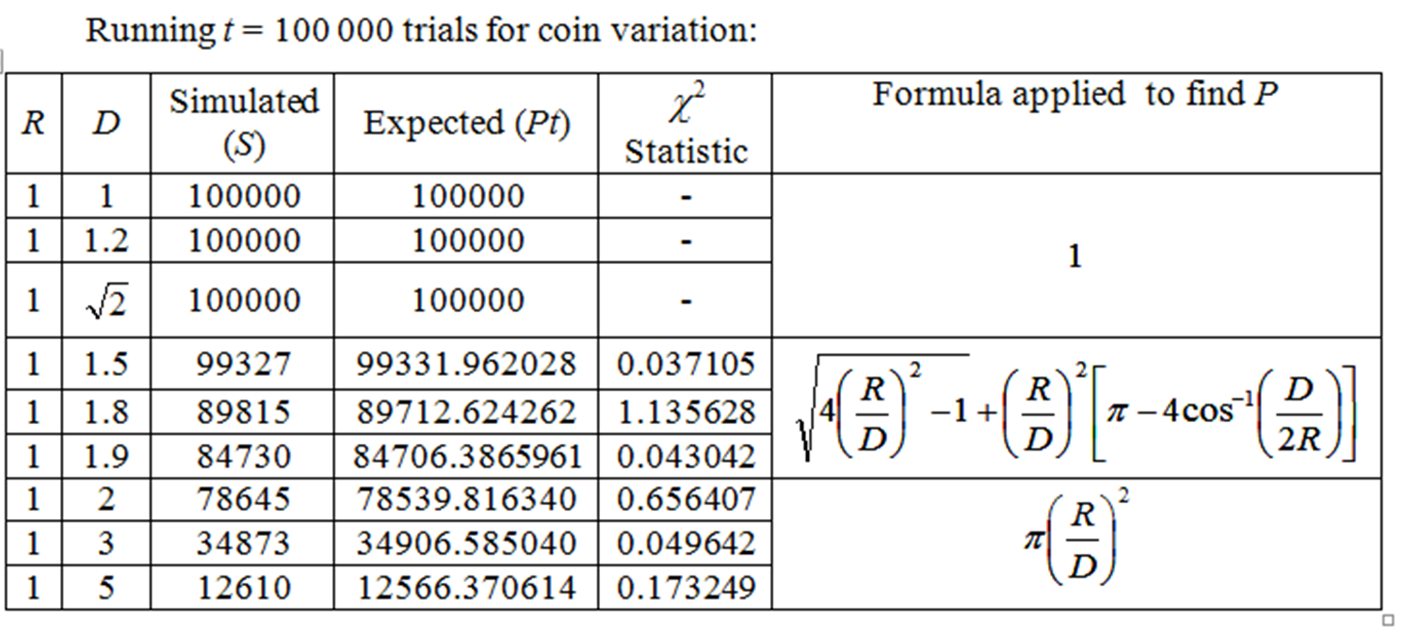
Comparing Formulae with Results of Simulations

Slide 49
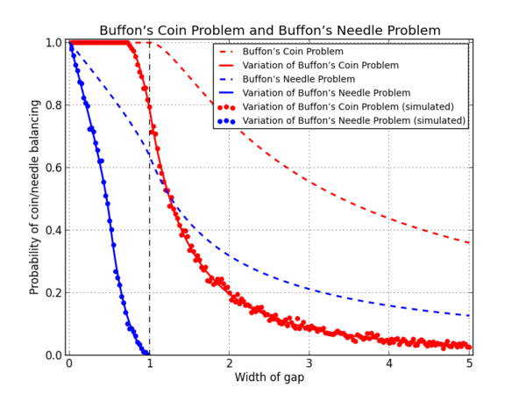
Comparing Formulae of Original and Variation of Buffon’s Needle and Coin Problem

Slide 50
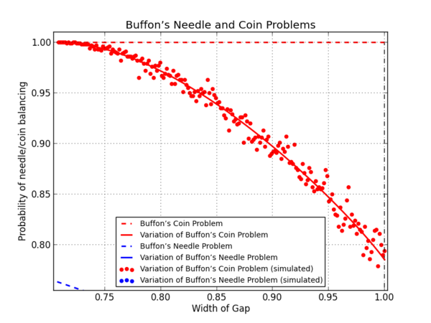
Comparing Formulae of Original and Variation of Buffon’s Needle and Coin Problem

Slide 51
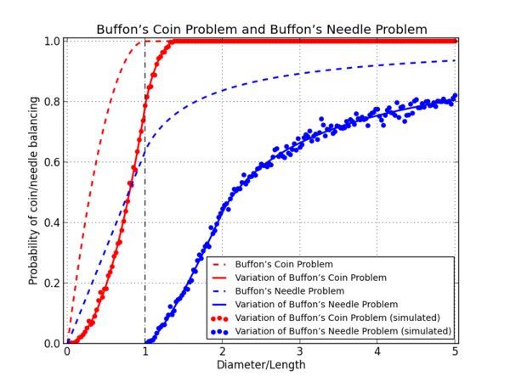
Comparing Formulae of Original and Variation of Buffon’s Needle and Coin Problem

Slide 52
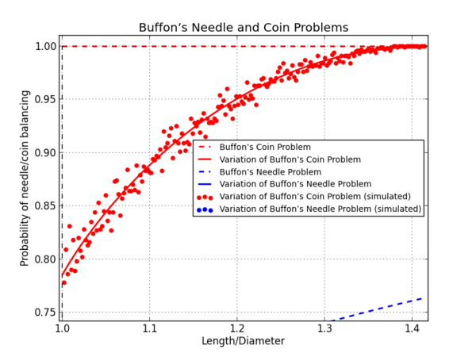
Comparing Formulae of Original and Variation of Buffon’s Needle and Coin Problem

Slide 53
Our Application

Slide 54
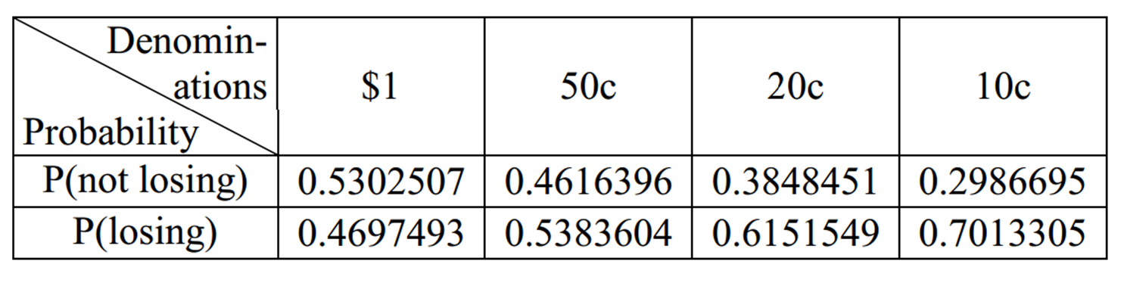
Finding the Best Combination of Coins to Carry

Slide 55
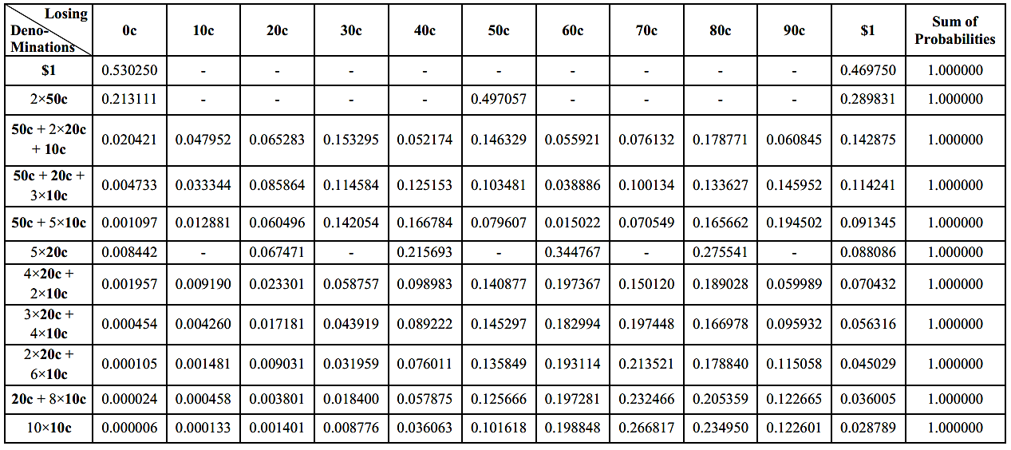

Slide 56
To find the best combination, the following criteria was used:
Lower probability of losing all the $1 worth of money
Lower probability of losing more than half the money

Slide 57
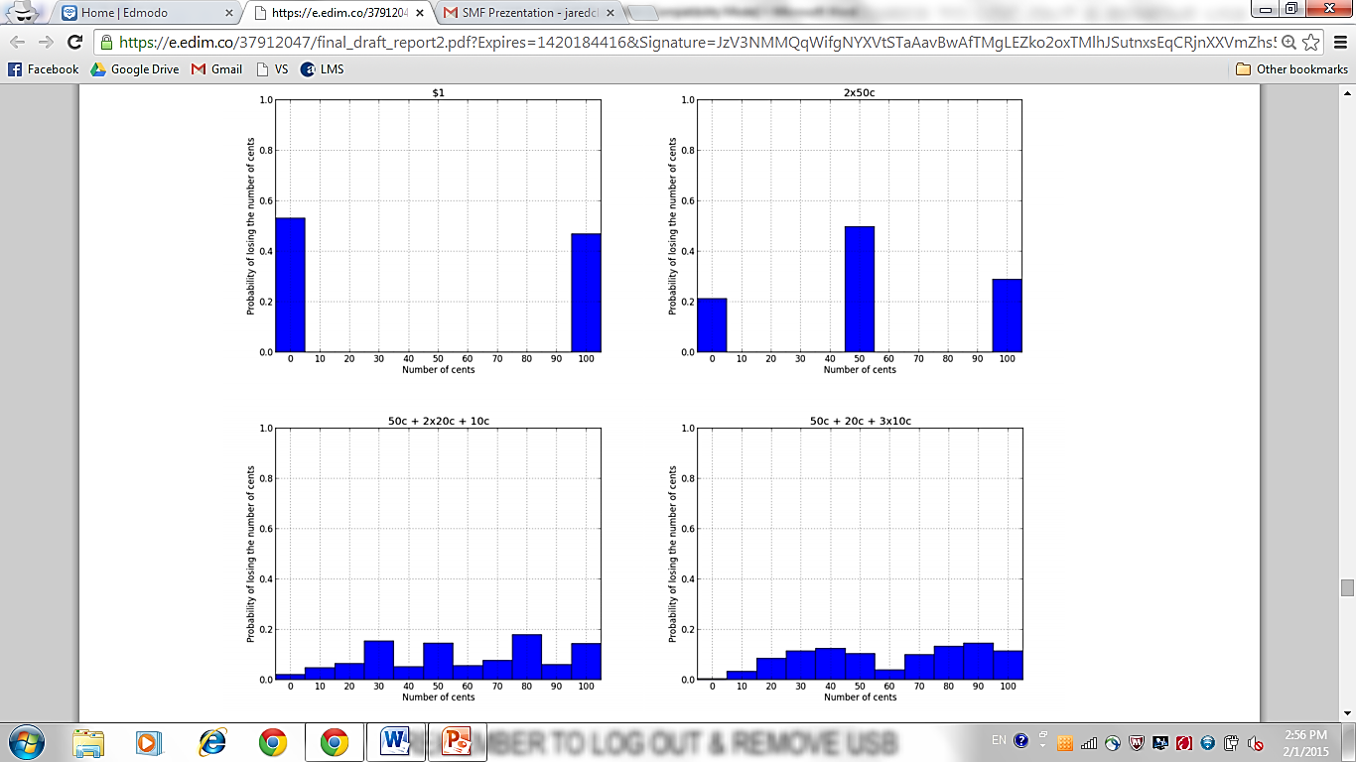

Slide 59
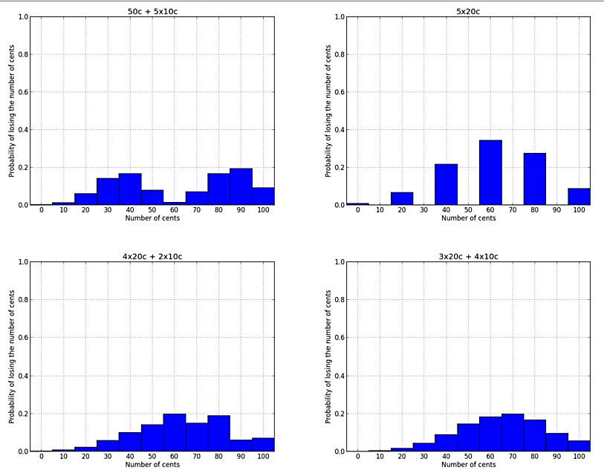

Slide 60
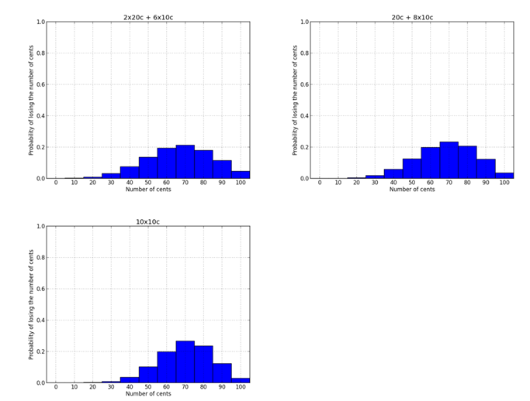

Slide 61
P(losing 60 cents or more) ≈ 0.51
P(losing 60 cents or more) ≈ 0.53

Slide 62
We recommend carrying the combination of one 50-cent, two 20-cent and one 10-cent coins.

Slide 63
Can we use the needle formula in our example?
Formulae for the probability of needle balancing can be used to approximate probability of coin balancing when coin falls vertically instead of landing flat.
Diameter of coins are all smaller than width of gap
Do not have a formula for L ≤ D for the variation of Buffon’s Needle problem

Slide 64
Conclusion

Slide 65
Assumptions
Gaps on drain cover are represented by either 2 parallel lines or single square grid
Needle or coin would always fall flat
Masses of needle and coin are uniformly distributed

Slide 66
where L is the length of the needle and D is the distance between the 2 parallel edges.
where R is the radius of coin and D is the length of side of the square grid.

Slide 67
Extensions
Improve the formula below
Explore other shapes, such as regular polygons

Slide 68
Thank you ☺ Our website can be found at tiny.cc/bce.

